Slide 1
SS ZG 526: Distributed Computing
Deadlocks in Distributed Systems
Chittaranjan Hota
Professor, Dept. of Computer Sc. & Information Systems
BITS, Pilani Hyderabad Campus, Hyderabad
hota@hyderabad.bits-pilani.ac.in

Slide 2
Edge-Chasing: Chandy-Misra-Haas
Some processes wait for local resources
Some processes wait for resources on other machines.
Algorithm invoked when a process has to wait for a resource for a longer period.
Uses local WFGs to detect local deadlocks and probes to determine the existence of global deadlocks.
Birla Institute of Technology and Science, Pilani (Deemed University)

Slide 3
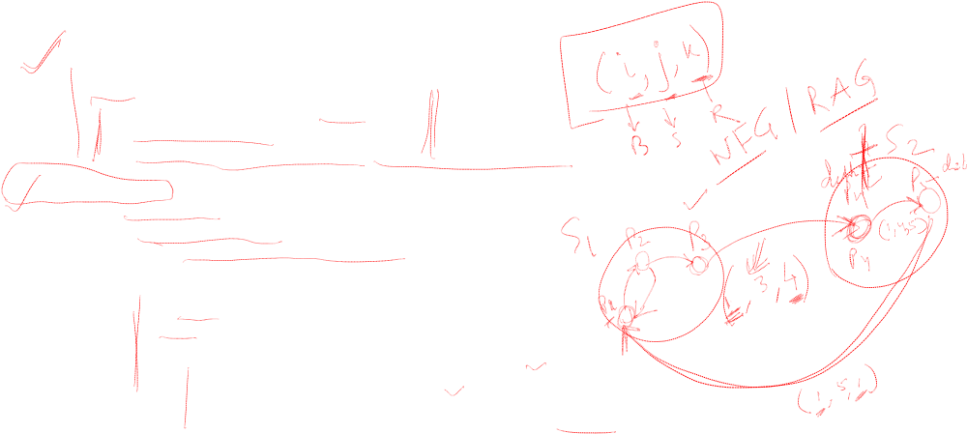
Chandy-Misra-Haas’s (CMH) Algorithm
Sending the probe:
if Pi is locally dependent on itself then deadlock.
else for all Pj and Pk such that
(a) Pi is locally dependent upon Pj, and
(b) Pj is waiting on Pk, and
(c ) Pj and Pk are on different sites, send probe(i,j,k) to the home
site of Pk.
Receiving the probe:
if (d) Pk is blocked, and
(e) dependentk(i) is false, and
(f) Pk has not replied to all requests of Pj,
then begin
dependentk(i) := true;
if k == i then Pi is deadlocked
else ...
for all Pm and Pn such that
(a’) Pk is locally dependent upon Pm, and
(b’) Pm is waiting on Pn, and
(c’) Pm and Pn are on different sites, send probe(i,m,n)
to the home site of Pn.
end.
Birla Institute of Technology and Science, Pilani (Deemed University)

Slide 4
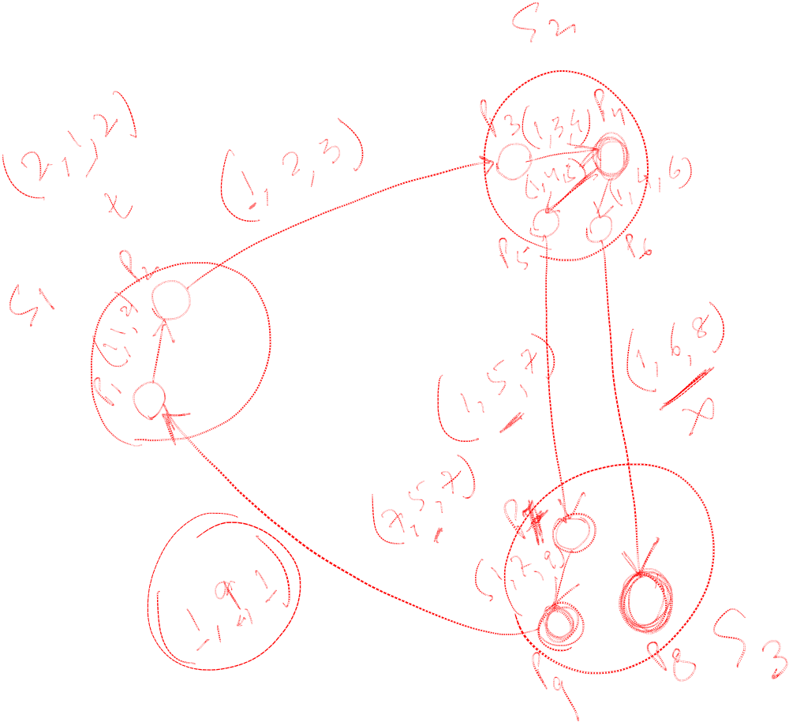
Example1 CMH
Birla Institute of Technology and Science, Pilani (Deemed University)

Slide 5
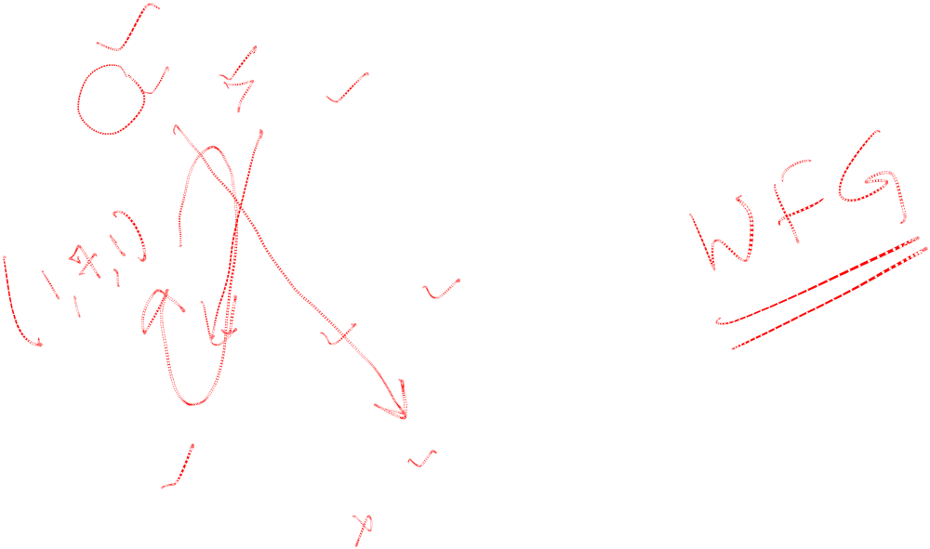
Example2 CMH
P2
P1
P3
P4
P7
P6
P5
Birla Institute of Technology and Science, Pilani (Deemed University)

Slide 6

Advantages and Disadvantages
Popular, Variants of this are used in locking schemes.
Easy to implement, as each message is of fixed length and requires few computational steps.
No graph constructing and information collection
False deadlocks are not detected
Does not require a particular structure among processes
Two or more processes may independently detect the same deadlock and hence while resolving, several processes will be aborted.
Even though a process detects a deadlock, it does not know the full cycle.
M(n-1)/2 messages required to detect deadlock, where M= no. of processes, n= no. of sites.
Birla Institute of Technology and Science, Pilani (Deemed University)

Slide 7
Next session
Chandy-Misra-Haas (CMH) algorithm for OR model (Diffusion computation)
Birla Institute of Technology and Science, Pilani (Deemed University)

